Slide 1


Electric Circuits
Twelfth Edition, Global Edition
Chapter 2 – Part 2
Circuit Elements
© 2024 Pearson Education Ltd. All Rights Reserved.
Notes:
If this PowerPoint presentation contains mathematical equations, you may need to check that your computer has the following installed:
1) Math Type Plugin
2) Math Player (free versions available)
3) NVDA Reader (free versions available)

Slide 2
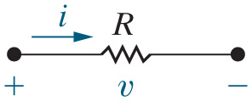

Chapter 2 – Circuit Elements (1 of 22)
Resistance
A measure of the capacity of a material to impede the flow of current.
The property of resistance is modeled by a resistor.
A resistor is also a circuit element that has a specified resistance associated with it.
Resistor
v is the voltage in volts [V]
i is the current in amps [A]
R is the resistance in ohms

Slide 3


Chapter 2 – Circuit Elements (2 of 22)
Resistors
Ohm’s Law describes the relationship between voltage and current in a resistor:
v is the voltage in volts [V]
i is the current in amps [A]
R is the resistance in ohms

Slide 4

Chapter 2 – Circuit Elements (3 of 22)
Not quite – the voltage in Ohm’s law is a signed quantity.
Ohm’s Law
How do you determine which sign to use? Use the passive sign convention!

Slide 5
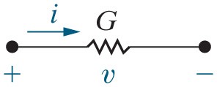
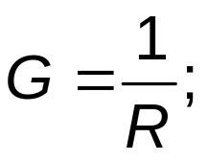

Chapter 2 – Circuit Elements (4 of 22)
More on resistors:
The inverse of resistance is conductance.
Conductance has the units Siemens, abbreviated “S”.

Slide 6


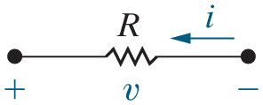
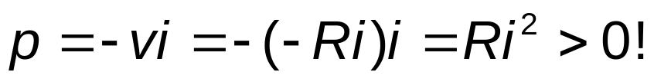
Chapter 2 – Circuit Elements (5 of 22)
More on resistors
Calculate the power in a resistor:
The power associated with a resistor is always positive. Therefore, resistors always absorb power!
Find the power for this resistor.

Slide 7
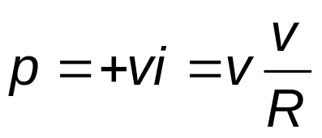
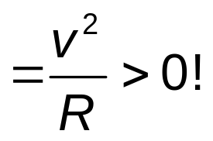
Chapter 2 – Circuit Elements (6 of 22)
More on resistors
Calculate the power in a resistor using voltage:
The power associated with a resistor is still positive.

Slide 8
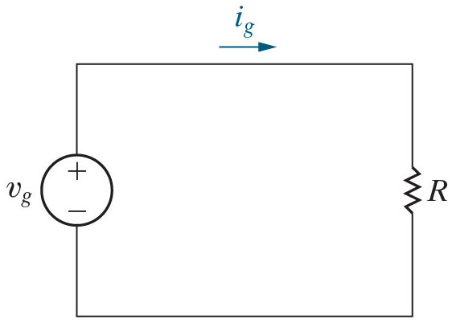


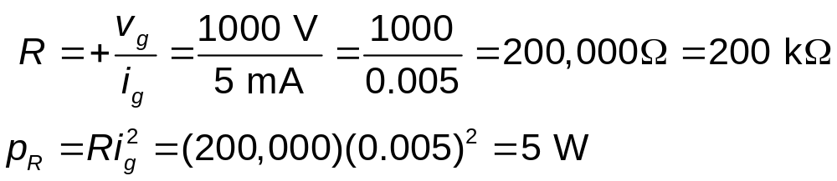
Chapter 2 – Circuit Elements (7 of 22)
Example:
Consider the circuit shown here.
(a) If
and
find
R and the power absorbed by the resistor.
Notes:
Long Description:
R equals positive StartFraction v subscript g over i subscript g EndFraction equals StartFraction 1000 Volts over 5 milliAmperes EndFraction equals StartFraction 1000 over 0.005 EndFraction equals 200,000 Ohms equals 200 kilo Ohms
p subscript R Baseline equals R i subscript g Baseline squared equals (200,000) multiplied by (0.005) squared equals 5 Watts.

Slide 9



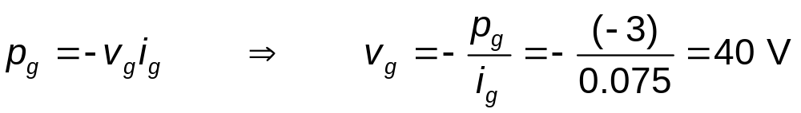
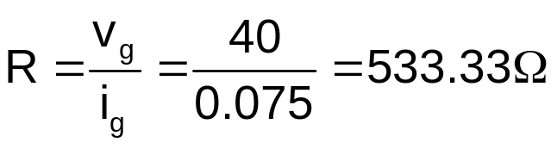


Chapter 2 – Circuit Elements (8 of 22)
Example, continued
Consider the circuit shown here.
(b) If
and
find
R and the power
absorbed by the resistor.
Notes:
Long Description:
p subscript g Baseline equals negative v subscript g Baseline i subscript g Baseline, Forward arrow, v subscript g Baseline equals negative Start Fraction p subscript g over i subscript g End Fraction equals negative Start Fraction Open Parenthesis negative 3 Close Parenthesis over 0.075 End Fraction equals 40 Volts.

Slide 10


Chapter 2 – Circuit Elements (9 of 22)
We just calculated the power of the resistor to be 3 W. Is the resistor supplying or absorbing power?
A. Supplying
B. Absorbing

Slide 11

Chapter 2 – Circuit Elements (10 of 22)
Suppose we are told that the voltage drop across a
resistor is 10 V. What is the power associated with the resistor?
A. 5000 W
B. 500 W
C. 2 W
D. I need to know the voltage polarity first

Slide 12
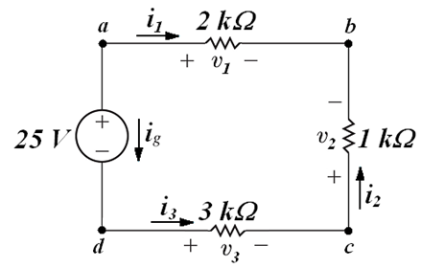
Chapter 2 – Circuit Elements (11 of 22)
Kirchhoff’s Laws
Consider the circuit shown below. We wish to “solve” this circuit. To solve a circuit, we must find all of the unknown voltages and currents.
How many unknowns are in this circuit? Seven – three unknown voltages and four unknown currents.

Slide 13
Chapter 2 – Circuit Elements (12 of 22)
To solve for 3 unknown voltages and 4 unknown currents, how many independent equations do we need?
A. 4
B. 7
C. 8
D. We need more information

Slide 14
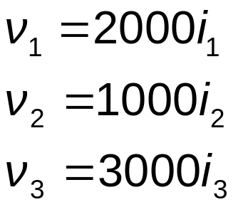
Chapter 2 – Circuit Elements (13 of 22)
Kirchhoff’s Laws (continued)
The only equations we know how to write at this point come from Ohm’s law. Let’s write them.

Slide 15
Chapter 2 – Circuit Elements (14 of 22)
Kirchhoff’s Laws (continued)
We need more equations – they will come from Kirchhoff’s laws.
Kirchhoff’s Current Law (K C L)
The algebraic sum of all the currents at any node in a circuit equals zero.
Note – a node is a point where two or more circuit elements are connected.

Slide 16
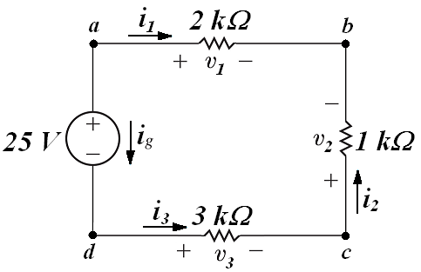
Chapter 2 – Circuit Elements (15 of 22)
How many nodes are in this circuit?
A. 4
B. 3
C. 2
D. None of the above

Slide 17





Chapter 2 – Circuit Elements (16 of 22)
Kirchhoff’s Current Law (K C L)
Let’s write the K C L equations at each node. Are they all independent?
Note that only 3 of the 4 are independent – the
equation
can be derived from the other 3.
a (leaving):
b (entering):
c (enter = leave):
d (leaving):

Slide 18
Chapter 2 – Circuit Elements (17 of 22)
If a circuit has 6 nodes, how many independent K C L equations can you write?
A. 7
B. 6
C. 5
D. None of the above

Slide 19
Chapter 2 – Circuit Elements (18 of 22)
Kirchhoff’s Laws (continued)
We have 3 equations from Ohm’s law and 3 (independent) K C L equations – we need one more equation, because we have 7 unknowns. That equation will come from Kirchhoff’s Voltage Law
Kirchhoff’s Voltage Law (K V L)
The algebraic sum of all the voltages around any closed path in a circuit equals zero.
Note – a closed path starts at any node, travels through selected circuit elements, and returns back to the starting node without including any intermediate nodes more than once.

Slide 20


Chapter 2 – Circuit Elements (19 of 22)
Kirchhoff’s Voltage Law (K V L)
Let’s write the K V L equation around the closed path formed by this circuit.
Start at node a and go clockwise:
Start at node d and go counter-clockwise:

Slide 21
Chapter 2 – Circuit Elements (20 of 22)
Kirchhoff’s Laws (continued)
Now we have 7 equations and 7 unknowns, so we can plug the 7 equations into a calculator and solve them to solve the circuit.
Analysis of circuits with resistors and constant sources is based on the use of Ohm’s Law, K C L and K V L.
However, we will develop some useful analysis techniques that will NOT require us to solve 7 equations for the simple example circuit we’ve been studying. Actually, we can solve this circuit with just 1 equation!

Slide 22
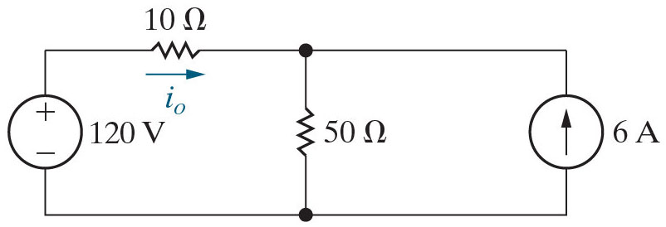
Chapter 2 – Circuit Elements (21 of 22)
How many voltages and currents are in this circuit?
A. 4 voltages; 4 currents
B. 4 voltages; 3 currents
C. 3 voltages; 4 currents
D. 3 voltages; 3 currents

Slide 23
Chapter 2 – Circuit Elements (22 of 22)
How many Ohm’s Law, K C L, and K V L equations will we need to solve this circuit?
A. 2 O L, 2 K C L, 2 K V L
B. 2 O L, 1 K C L, 3 K V L
C. 2 O L, 3 K C L, 1 K V L

Slide 24

Copyright
This work is protected by United Kingdom copyright laws and is provided solely for the use of instructors in teaching their courses and assessing student learning. Dissemination or sale of any part of this work (including on the World Wide Web) will destroy the integrity of the work and is not permitted. The work and materials from it should never be made available to students except by instructors using the accompanying text in their classes. All recipients of this work are expected to abide by these restrictions and to honor the intended pedagogical purposes and the needs of other instructors who rely on these materials.

